Slide 2
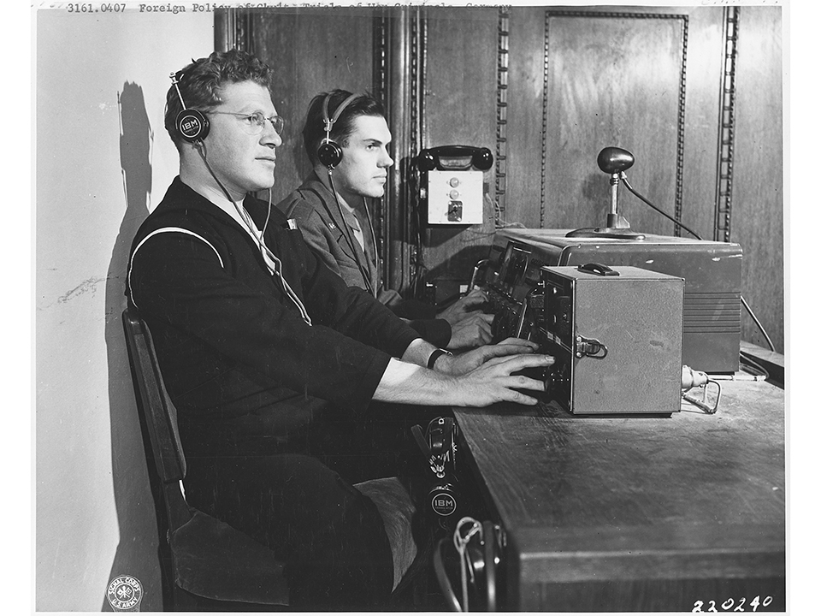

Slide 3
Paris-Nairobi (“Symphonie Satellite”) experiment by UNESCO in 1976

Slide 4
New York-Buenos Aires experiment by the United Nations in 1978. A series of experiments was conducted by the European Commission in 1995 (Studio Beaulieu), and a pilot study on ISDN video telephony for conference interpreters was carried out by the European Telecommunications Standards Institute in 1993. The European Commission launched another test in 1997 (Zaremba, 1997) and yet another in 2000 (European Commission, 2000

Slide 5
The current definition of “conference” in ISO 23155:
conference
a structured formal meeting, or set of meetings, following an established agenda in which issues, ideas and policies are discussed
conference interpreting
interpreting used for multilingual communication at political, scientific, technical and other formal meetings

Slide 6
Remote vs Distance

Slide 7
Distance interpreting
Information and communications technology (ICT)-enabled interpreting of a distant speaker at a given event.
Teleconference Interpreting
ICT-enabled distance interpreting of a remote speaker, where the interpreter has a direct view of some or all the other participants at a given event.
Videoconference Interpreting
ICT-enabled interpreting of a distant speaker, where the interpreter has a video-mediated view of that speaker and a direct view of some or all the other participants at a given event.
Audioconference Interpreting
ICT-enabled interpreting of a distant speaker, where the interpreter has a direct view of some or all the other participants at a given event but no view of that speaker.

Slide 8
Remote Interpreting
ICT-enabled distance interpreting of a remote speaker, where the interpreter has no direct view of the participants at a given event.
Video Remote Interpreting
ICT-enabled interpreting of a distant speaker, where the interpreter has a video-mediated view of that speaker but no direct view of the participants at a given event.
Multiscreen Video Remote Interpreting
ICT-enabled interpreting of a distant speaker, where the interpreter has a video-mediated view both of that speaker and some or all of the other participants at a given event
Single-Screen Video Remote Interpreting
ICT-enabled interpreting of a distant speaker, where the interpreter has a video-mediated view of that speaker but no view of the other participants at a given event.
Audio Remote Interpreting
ICT-enabled interpreting of a distant speaker, where the interpreter has neither a video-mediated nor direct view of that speaker or any other participants at a given event

Slide 10
By way of example, diplomatic interpreters are often asked to perform audio remote interpreting via telephone; audioconference interpreting is used at the ICC for certain judges’ plenaries, job interviews and audioconferences between the defence and their witnesses in the field; single-screen video remote interpreting has become very common where a booth is placed outside an event due to “lack of space”; multi-screen video remote interpreting is now used for Ministerial and European Council Meetings; and most conference interpreters by now will probably have had to interpret at least one speaker appearing via video-link.

Slide 12
Does remote interpreting impact on quality, fatigue or stress?
As to the onset of fatigue, hence the onset of decline in performance, we observed the same interpreter will tire faster (error rates increase) between the middle and the end of a turn in the remote condition as compared to the live condition, where error rate increases are known to occur past the normal end of turn time (past the 30 minute mark on average) (Moser-Mercer, Künzli & Korac, 1997). The onset of fatigue under remote conditions, as evidenced by a decrease in performance, appears to occur fairly soon after “half-time”, i.e. somewhere between 15 and 18 minutes into a 30-minute turn. Quality of performance then declines consistently irrespective of time of day…. We therefore need to conclude that remote interpretation increases an interpreter’s mental workload and leads to fatigue and decline in performance faster than live interpretation (Moser-Mercer, 2003).

Slide 13
The duration of an interpreter’s turn in a video link will require attention. The conference interpreting profession has adopted 30-minute turns as the standard duration of a working turn for a conference interpreter. Our data and Moser- Mercer’s study show a decline in the interpreting quality (increase in the number of errors) after approximately 15 to 20 minutes, suggesting that interpreters may not be able to work for an extended period of time in a video link. What is noteworthy is that the guidelines for remote interpreting issued by the Wisconsin Circuit courts, which recommended 30 minute turns in 2006, were revised in 2010 and now recommend 15 minutes as the maximum length (Braun, 2011, p.279).

Slide 14
Features
In the 100% decentralised paradigm, conference interpreters are treated as any other category of participants: they can be located at their office or at home. After all, isn’t this the whole purpose of web conferencing? No one should have to move; interpreters can also work alone from their home or office.
The additional bonus for conference organisers is that hiring a certain language/ language combination is not limited to a certain country or continent or time zone. Availability of interpreters should not be an issue anymore.

Slide 15
Distance conference interpreting is still conference interpreting, only more difficult. The new (business) model fails to recognise this: lack of co-location of interpreters (working into the same language) does not meet the needs of/ provide adequate working conditions to conference interpreters. The product offered is not conference interpreting anymore.

Slide 16
Additional cognitive load and stress resulting from the virtual, non-intuitive console (new tasks not related to interpreting (chat), excessive multitasking, distractions from interpreting per se);
Additional work load and stress resulting from the absence of a booth mate, thus removing teamwork from conference interpreting;
Uncertainty in view of lack of technical support (when working from home).
A sense of alienation and a feeling of isolation due to the interpreters’ remoteness
Additional tasks created by the use of the platform (e.g., chat boxes to communicate with boothmates, teammates, platform provider or end customer) and for which the interpreter may not have been trained or qualified
Constantly changing technology
Heightened anonymity
Acoustic shock

Slide 17
Platforms were invented to serve the 100% decentralised model, but they don’t have to be used this way, i.e. with interpreters working alone. The problem is that the new business model pushes distance conference interpreting to the extreme, to lower costs but also because platform owners are generally not familiar with our profession.

Slide 18
Code of Professional Ethics: The invisibility of interpreters working solo from unknown locations means that it will be more difficult to enforce our Code of Professional Ethics. It will be more difficult to know who does what: working hours, breaks, language combination offered, competence, quality.

Slide 19
Message
• Conference interpreters should embrace technological progress without fear. We should be at the forefront and set the rules to protect quality in conference interpreting.
• We should work with technology owners to help them better understand conference interpreting.
• We should educate our clients about the different categories of interpreting.

